Slide 1
Credit-card-Fraud-Detection
CAPSTONE PROJECT
Presented By:
R.SUDHARSAN –CARE College of Engineering – MECHANICAL ENGINEERING

Slide 2
OUTLINE
Problem Statement
Proposed System/Solution
System Development Approach
Algorithm & Deployment
Result
Conclusion
Future Scope
References

Slide 3
Problem Statement
The rise of e-commerce and digital transactions has unfortunately facilitated an increase in credit card fraud. Fraudsters employ various methods to steal card information and make unauthorized purchases, causing significant financial losses for both cardholders and issuing institutions.

Slide 4
Proposed Solution
1. Data understanding and exploring
2. Data cleaning
• Handling missing values
3. Exploratory data analysis
• Univariate analysis
• Bivariate analysis
4. Prepare the data for modelling
• Check the skewness of the data and mitigate it for fair analysis
5. Split the data into train and test set
• Scale the data (normalization)
6. Model building
• Train the model with various algorithm such as Logistic regression, SVM,
Decision Tree, Random forest, XGBoost etc.
• Tune the hyperparameters with Grid Search Cross Validation and find the optimal values of the hyperparameters.
7. Model evaluation
• As we see that the data is heavily imbalanced, Accuracy may not be the correct measure for this particular case.

Slide 5
System Approach
Continuous Monitoring and Improvement: Monitor the performance of deployed models in real-time and collect feedback on their effectiveness in detecting fraud. Collaboration and Information Sharing: Collaborate with other financial institutions, regulatory agencies, and industry partners to share insights and best practices for fraud detection and prevention. Participate in fraud detection networks and consortiums to leverage collective intelligence and enhance the effectiveness of fraud detection efforts across the industry. Systematic approach, financial institutions and credit card issuers can develop robust fraud detection systems that effectively identify and mitigate fraudulent activities, thereby safeguarding the interests of cardholders and maintaining trust in the financial ecosystem.

Slide 6
Algorithm & Deployment
Local Outlier Factor The Local Outlier Factor or LOF algorithm is an unsupervised anomaly detection method. It computes the local deviation of a given a data point with respect to its neighbors. Local Outlier Factor considers as outliers the samples that have a substantially lower density than their neighbors. Isolation Forest Algorithm The Isolation Forest ‘isolates’ observations by randomly selecting a feature and then randomly selecting a split value between the maximum and minimum values of the selected feature. Since recursive partitioning can be represented by a tree structure, the number of splitting required to isolate a sample is equivalent to the path length from the root node to the terminating node. This path length, averaged over a forest of such random trees, is a measure of normality and our decision function. Random partitioning produces noticeably shorter paths for anomalies. Hence, when a forest of random trees collectively produce shorter path lengths for particular samples, they are highly likely to be anoma.

Slide 7
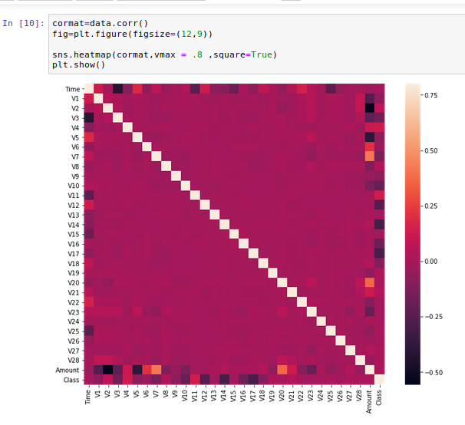
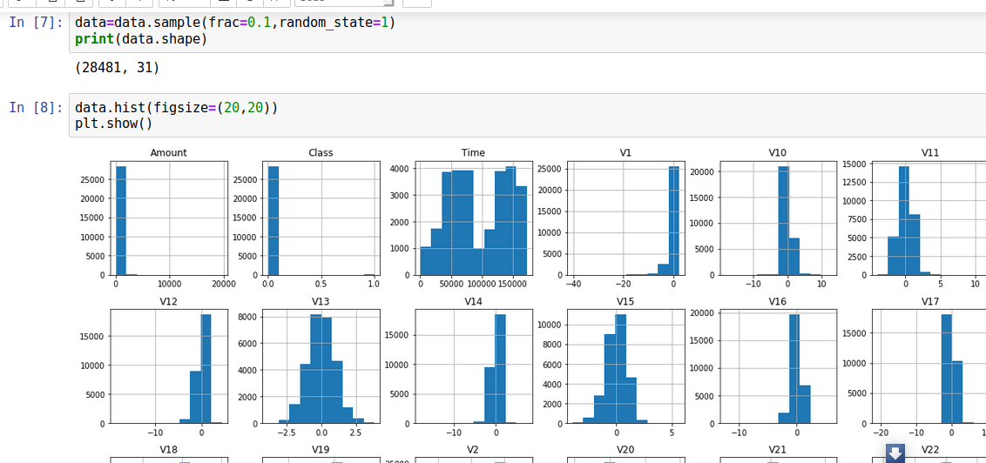
Result

Slide 8
Conclusion
In conclusion, Credit card fraud poses a significant threat to both financial institutions and cardholders. A well-designed credit card fraud detection system, built on a system approach, can significantly reduce financial losses and enhance security.

Slide 9
Future scope
The fight against credit card fraud is an ongoing battle, requiring continuous innovation and adaptation. The fight against credit card fraud is an ongoing battle, requiring continuous innovation and adaptation. Here are some exciting possibilities for the future of credit card fraud detection

Slide 10
References
Visit https://www.irjet.net/archives/V5/i11/IRJET-V5I11304.pdf Visit https://acadpubl.eu/jsi/2018-118-7-9/articles/7/31.pdf Visit https://arxiv.org/pdf/1811.02196.pdf Visit https://towardsdatascience.com/anomaly-detection-with-isolation-forest-visualization-23cd75c281e2

Slide 11
THANK YOU

